Slide 1
Digital Development Series Introduction to Data Services Team
August 22, 2018

Slide 2
Agenda
Data Services Overview
Data Services Principles
Network Value Delivery (Rowdmap) Team Overview

Slide 3
Digital Mission Statement
All Cotiviti Data lives on platform and is used by apps to maximize value
All Cotiviti value is generated on platform
Platform solutions & data outperform all others

Slide 4
Data Services Team Principles – Inbound Data
All Inbound Data Starts With No Transformation
Store the client data exactly as received
In payment accuracy, bad data isn’t bad!
Allow Us To Time Travel
Establish the state of data as of any point in time
Data Is Treated Like Code
Reference data is tagged and versioned just like code libraries
Breaking Down Barriers
No data driven distinction between PCA, RCA, CCV, etc.

Slide 5
Data Services Team Principles – Transformations & Insights
All Transformations Are Well Understood And Documented
Downstream processes need to know how their data got there
Minimal changes are preferable to assuming standardized data
If transformations do occur, maintain complete traceability
Code version
GUID, machine name, timestamp, process
The Insight Model Provides a Standard Mechanism For Understanding Transforms
Recommendation for a change to data is, in itself, an Insight
Governance will determine Insights that get moved upstream to the general ingestion process

Slide 6
Data Services Team Principles – Data Model
A Single, Monolithic EDM Isn’t Necessary
Accounting for 1500+ field mappings to start with isn’t sustainable
A relatively small number of fields provide the majority of our value
Specific data models driven by industry standards provide baseline stability
1450, 1500 Forms
Data Models Are Code Libraries
Version and deprecate over Time
Multiple versions of a model can exist at a point in time
v3.0.1.1, v3.0.1.2, v3.0.1.3…
Rule and model dependencies are accounted for in the Rule definitions

Slide 7
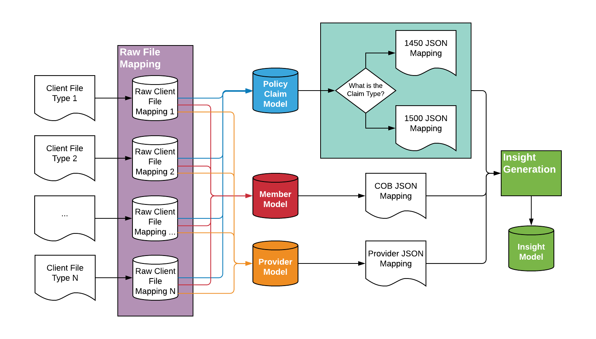
C2i v2 Data Flow

Slide 8
Network Value Delivery & Data Services

Slide 9


Together We Can Deliver More Value for Clients
Leading payment accuracy company using analytics-driven solutions to unlock value in complex payer-provider interactions
Analytics & Insights
High Value Care
Network Value
Payment Accuracy
Value-based analytics company using comprehensive benchmarks to identify, quantify and reduce low-value care

Slide 10
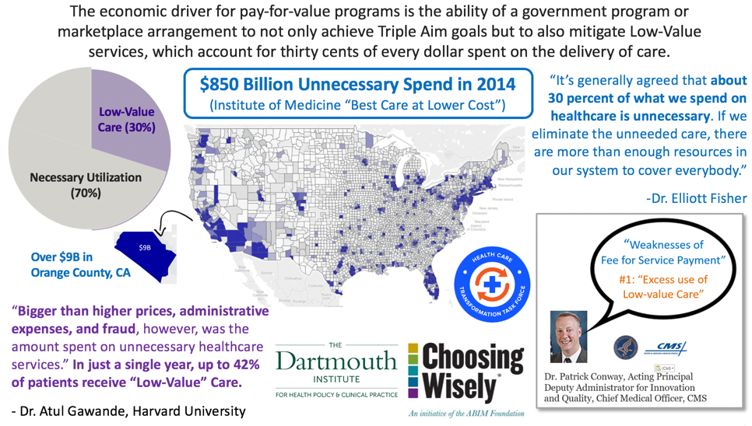
Supporting Value Transformation: What’s at Stake:

Slide 11

Portland Team: Data Services
Informatics
Data intake
Public data
Client network rosters
Client claims
Data manipulation/prep
Quality checking
“All Hands on Deck”
Development
Quality check improvements
Process automation
Network Value Delivery
Product development
Product delivery
Provider data integrity
Answering questions

